Slide 1
Intern Weekly Report Summary
MSRA HEX Intern
Jack Zeng
June - September 2023

Slide 2
General goals (not all)
Enhance LLM’s ability on edge side, reduce cost on server side
Edge side: Laptop, smartphone, small business’ servers…
Decrease the difference between smaller LLM and larger LLM
Try to train and implement a “personalized” edge-side LLM
Could answer private information questions

Slide 3
Week 1 & 2
Transformer Intro

Slide 4
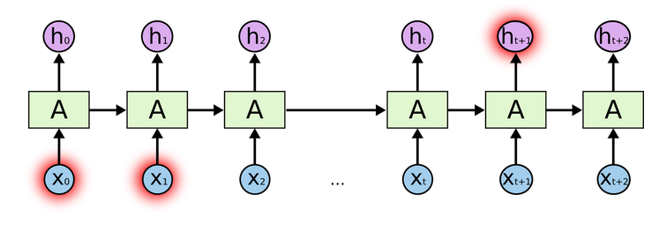
Transformer: Why not RNN?
RNN generates hidden states -> precludes parallelization
Long-term dependency problem
Potential solution: LSTM

Slide 5
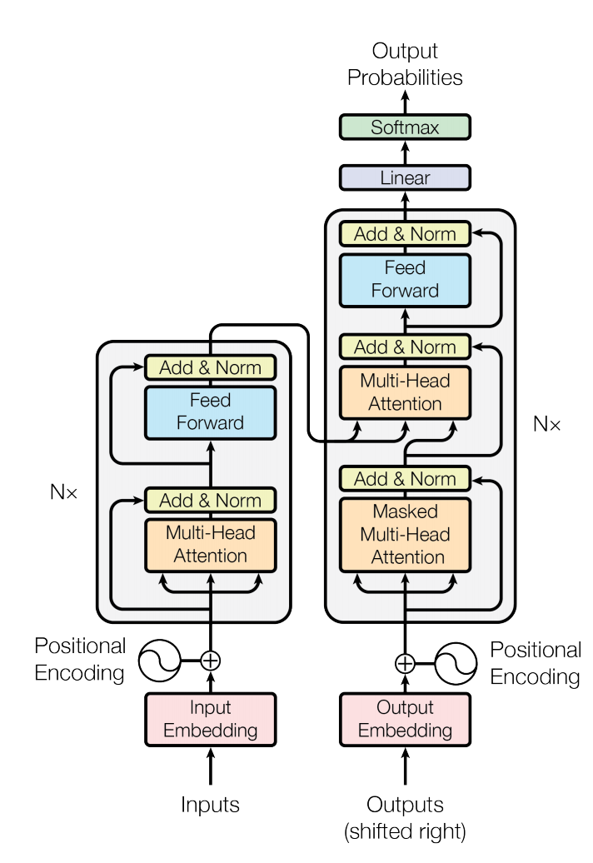
Transformer: Structure
Left part: encoder
Right part: decoder
It consists
Adding and Normalization Layer
Feed-Forward Layer
Multi-Head Attention Layer
Positional Encoding

Slide 6
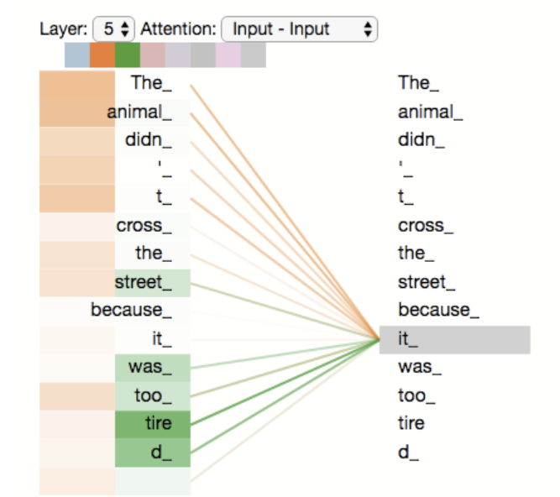
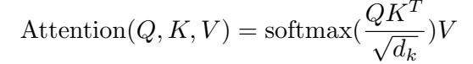
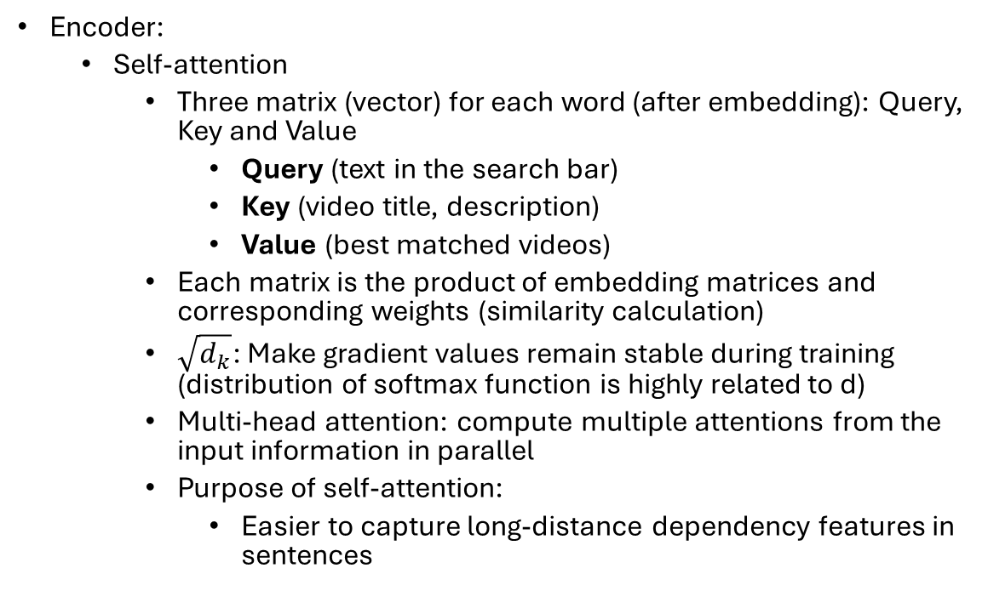
Transformer: Encoder and Decoder in Detail
Encoder:
Self-attention
Three matrix (vector) for each word (after embedding): Query, Key and Value
Query (text in the search bar)
Key (video title, description)
Value (best matched videos)
Each matrix is the product of embedding matrices and corresponding weights (similarity calculation)
$\sqrt{d_{k}}$: Make gradient values remain stable during training (distribution of softmax function is highly related to d)
Multi-head attention: compute multiple attentions from the input information in parallel
Purpose of self-attention:
Easier to capture long-distance dependency features in sentences

Slide 7
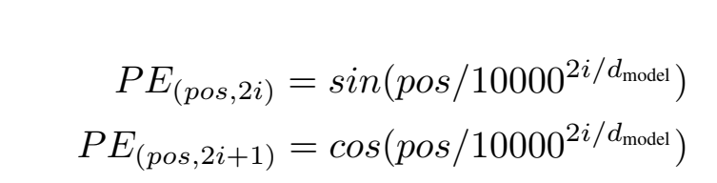
Transformer: Continue…
“Encoder-Decoder” Attention (masked attention)
Same calculation method as self-attention
Q -> last output from decoder
K and V -> outputs from encoder
Purpose: focus on appropriate place in the input
Position Encoding: Provide relative location info

Slide 8
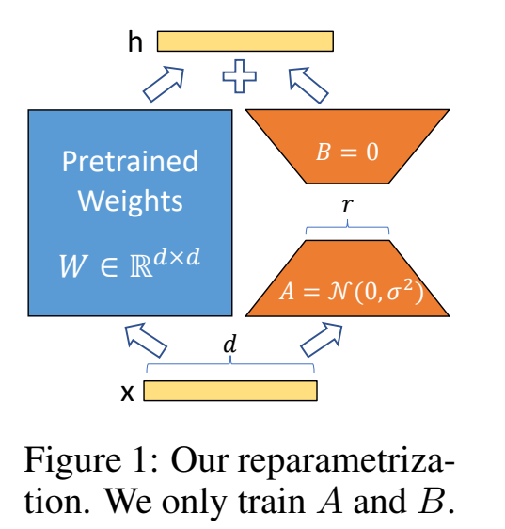
LoRA (Low-Rank Adaptation)
Low-rank transformation:
Approximate high-dimensional matrix using low dimensional representation
Purpose: Increase fine tuning efficiency
Low intrinsic dimension
Key idea:
Decompose weight update matrix into two smaller (A and B on the right)
Train matrix A and B only

Slide 9
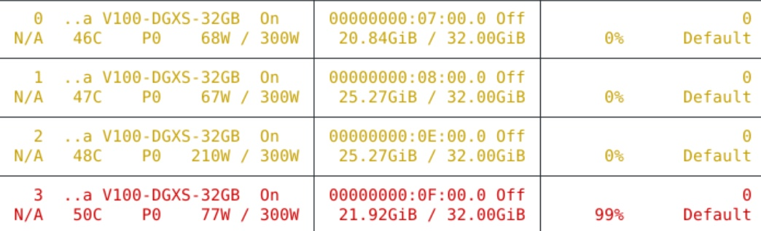
LoRA Applications and Issues (On week 2)
Using LoRA to fine-tune ChatGLM-6B
Issues:
GPU usage (solved by using Hugging Face’s Accelerate)
Prompting (not solved yet)

Slide 10
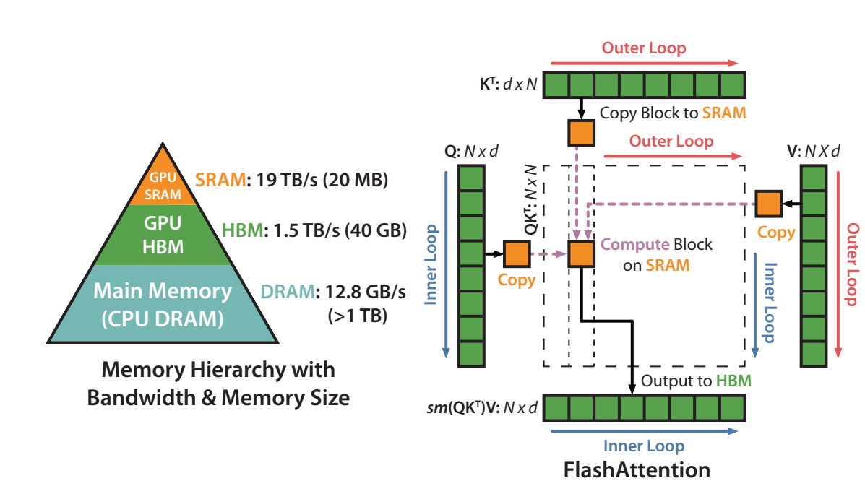
Flash Attention (Roughly)
Key idea: dividing operations between faster and slower levels of GPU memory
Compute-bound and memory-bound
For transformer, bottleneck -> attention matrix on the HBM and repeating read/write
Tilting: split the inputs Q, K, V into blocks and combine
Recompute: store softmax()

Slide 11
Week 3
Huggingface Transformer

Slide 12
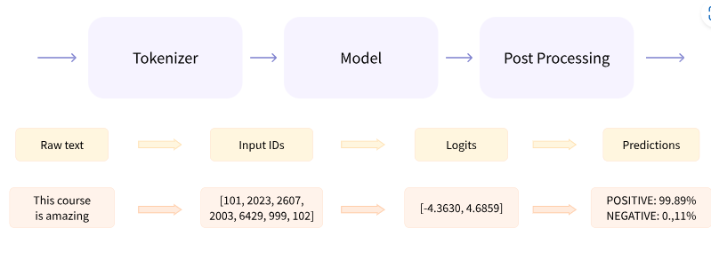
Huggingface API Structure
Basic APIs:
Transformer
Tokenizer
Datasets
Trainer

Slide 13
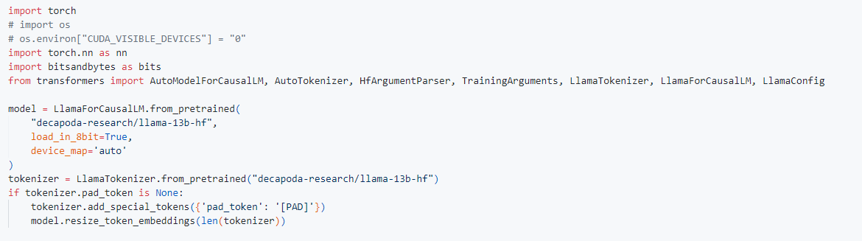
Setup and Tokenizer Initialization
Model: LLaMA 13B
Checkpointing Shard: 14GB GPU memory
For LLaMA 8B, 8.5GB GPU memory

Slide 14
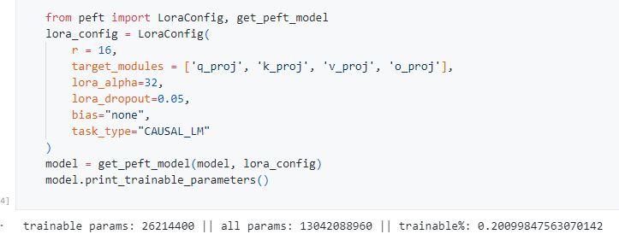
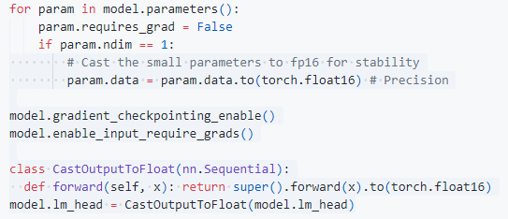
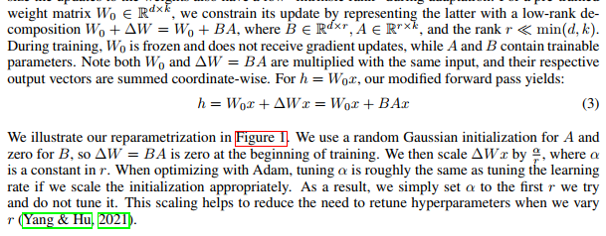
Precision and LoRA Setup
LoRA parameter settings

Slide 15
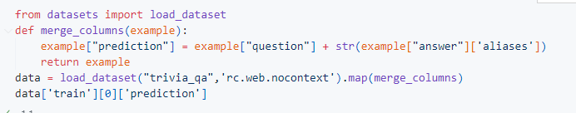
Dataset Setup (cont.)
Example:

Slide 16
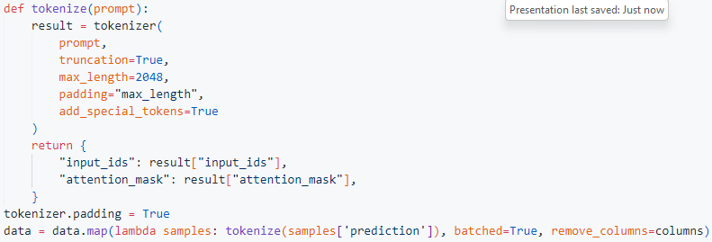
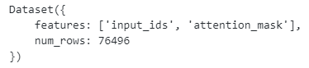
Tokenization

Slide 17
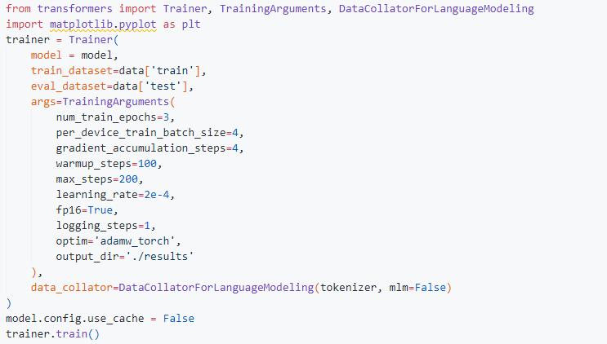
Training

Slide 18
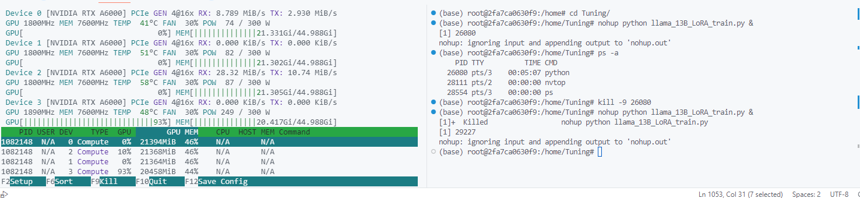
Issue (Week 3)
Potential Solutions:
Huggingface Accelerate
Pytorch Script: https://huggingface.co/docs/transformers/run_scripts#distributed-training-and-mixed-precision
DeepSpeed

Slide 19
Week 4
PEFT Intro

Slide 20
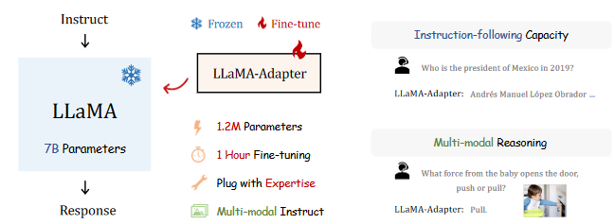
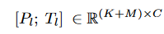
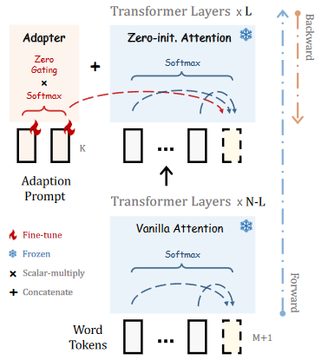
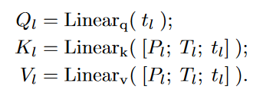
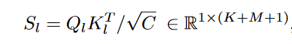
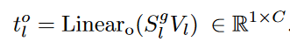
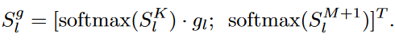
Llama-Adapter
Learnable Adaption Prompt
Instruct fine-tuning
-
K -> instruction length, C -> feature dimension, T -> word with length M
Only insert prompt into topmost L layers
Purpose: Guide T to generate subsequent contextual response
Zero-init Attention and learnable gating factor
Purpose: Solve the disturbance to the word tokens brought by adaption
Change last L transformer layers
Gating factor: control the importance of attention score

Slide 21
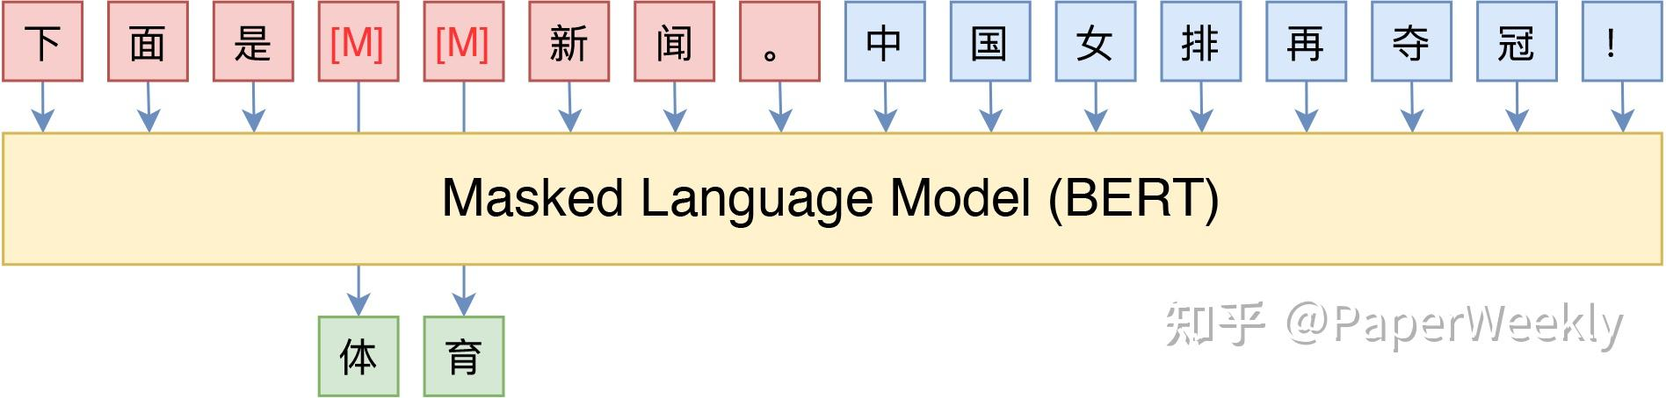
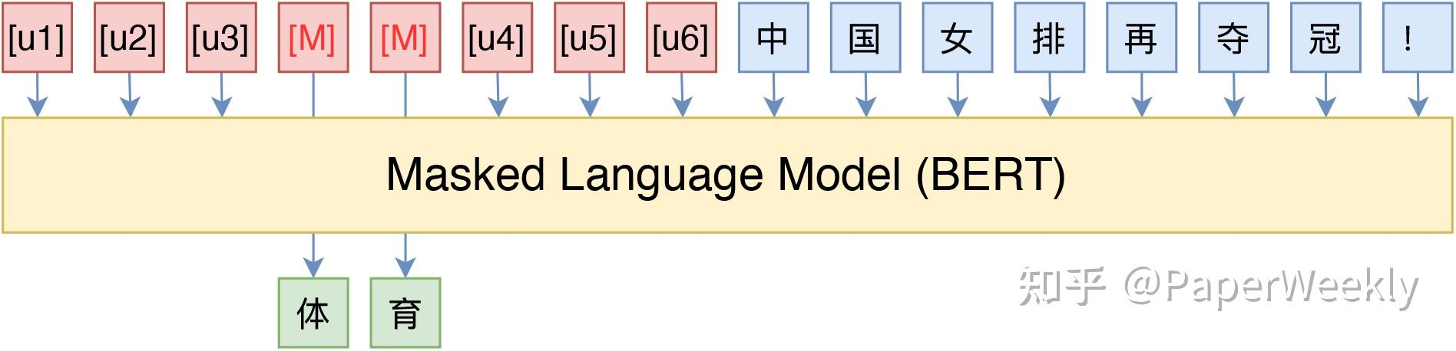
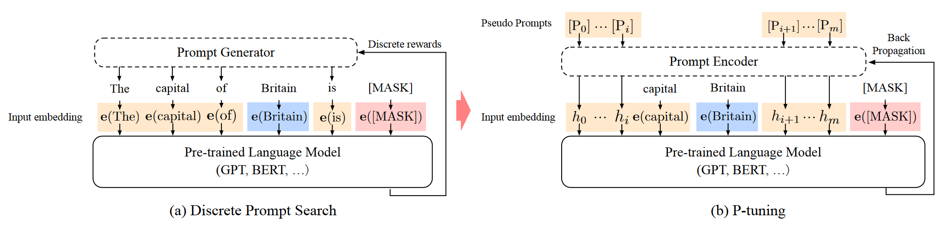
P-tuning
Key: using pre-existed annotation dataset to auto generate masked prompt
Solve NLU problems
Fix the weights of the whole model and optimize the embedding of only the tokens [unused1]～[unused6]
Using a small LSTM to calculate the embedding
Advantage: save time

Slide 22
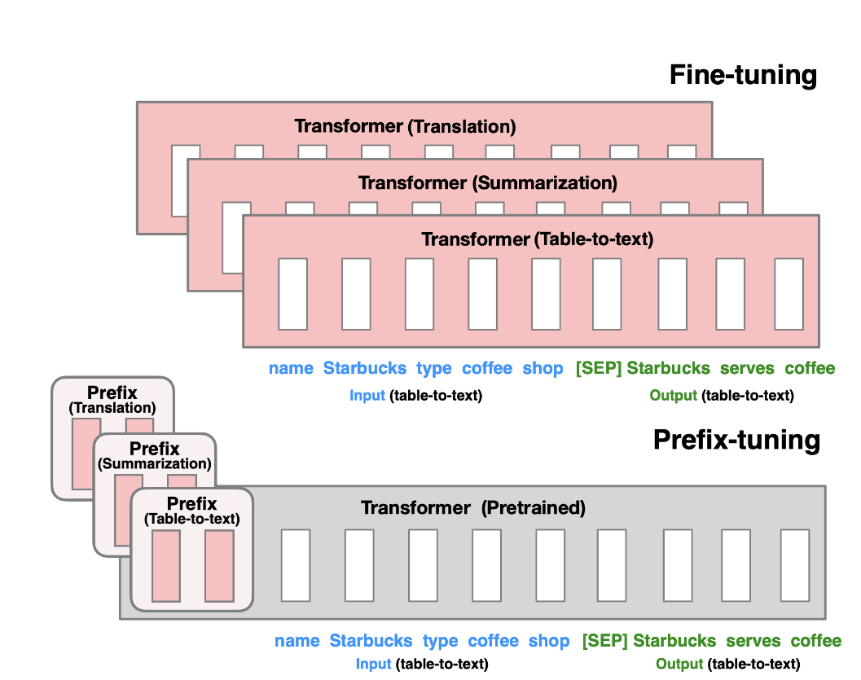
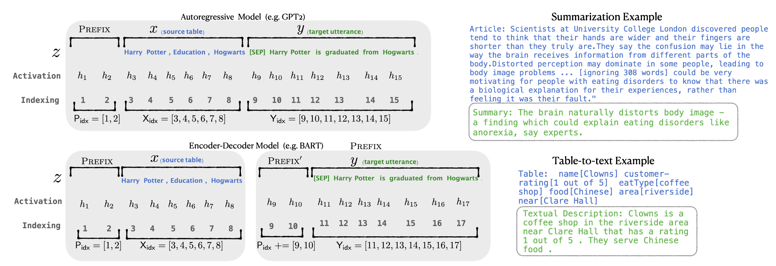
Prefix-Tuning
Key: Frozen the model weight, optimize continuous task-specific vector
Focus: table-to-text, summarization problem
Store a transformer model + specific prefix vector
Mapping a MLP matrix

Slide 23
Week 5
Instruction Tuning

Slide 24
Instruction Tuning: Paper List
Finetuned Language Models Are Zero-Shot Learners (2021, FLAN)
Multitask Prompted Training Enables Zero-Shot Task Generalization (2021, T0)
Scaling Instruction-Finetuned Language Models (2022, FLAN-PaLM)
Self-Instruct: Aligning Language Model with Self Generated Instructions

Slide 25
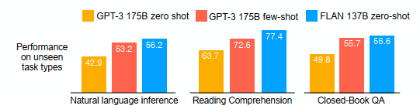
Instruction Tuning: FLAN
GPT-3: Prompt Tuning
Question: Worse performance in Zero-Shot question
Potential reason: without few-shot examples, worse ability of inference if input prompt doesn’t match tuning format
Reality scenario: User asks zero-shot questions more.

Slide 26
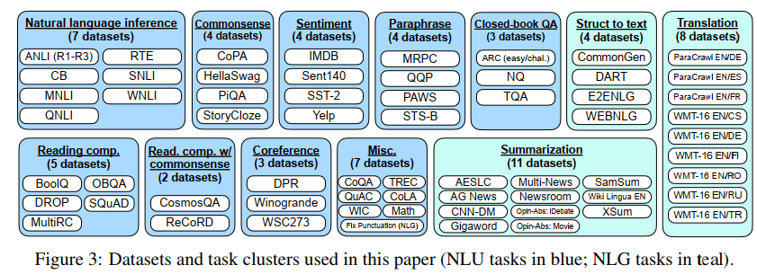
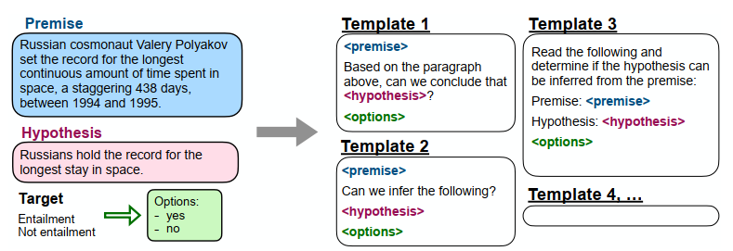
FLAN: Datasets and templates
10 templates for each dataset

Slide 27
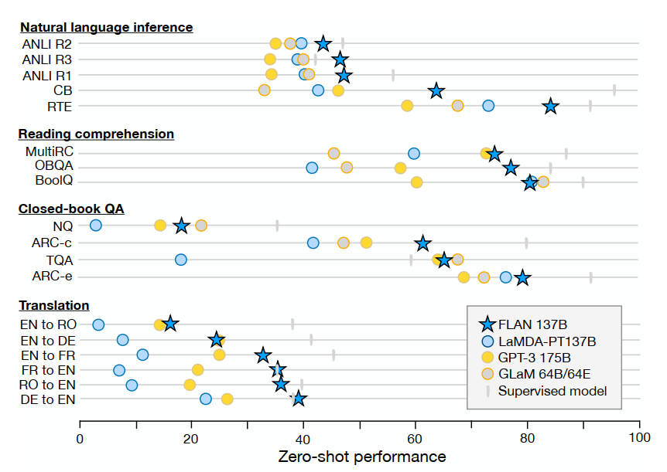
FLAN: Result
Better performance:
NIL
QA
Reading Comprehension
Translation
Worse performance:
Commonsense Reasoning
sentence completion

Slide 28
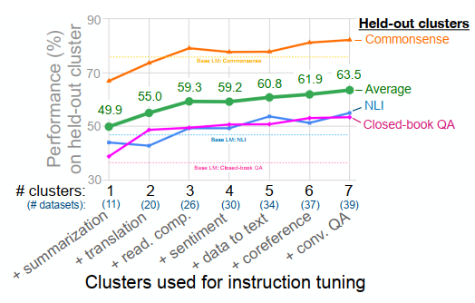
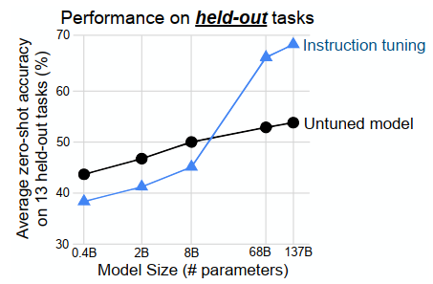
FLAN: Other Facts
Performance of solving unseen tasks:
Scaling Law:

Slide 29
Instruction Tuning: T0
Differences between FLAN:
More prompts/templates: 620 vs. 2073
Different pretrain model structure: decoder-encoder (T0) vs. decoder-only (FLAN)

Slide 30
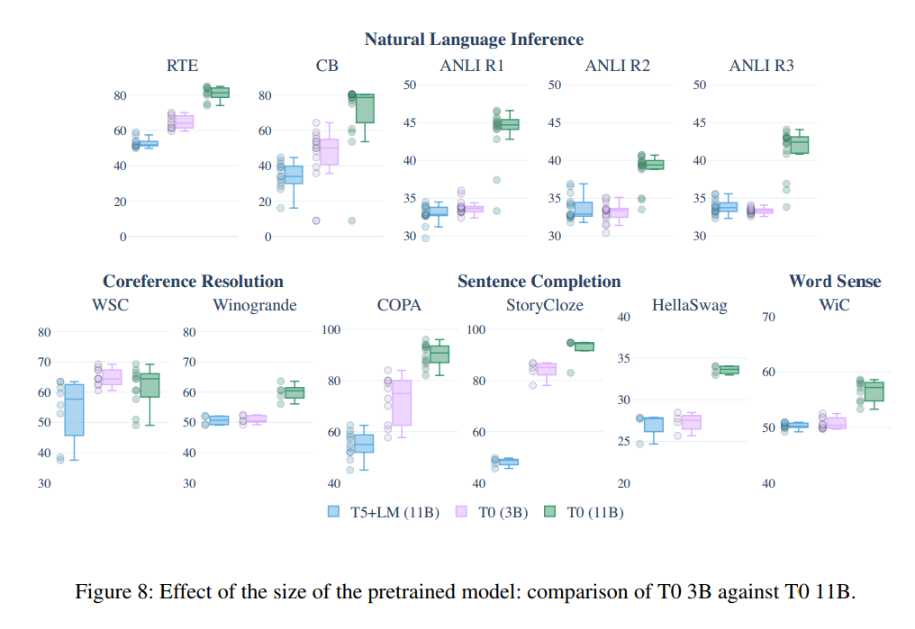
T0: Result and Comparison

Slide 31
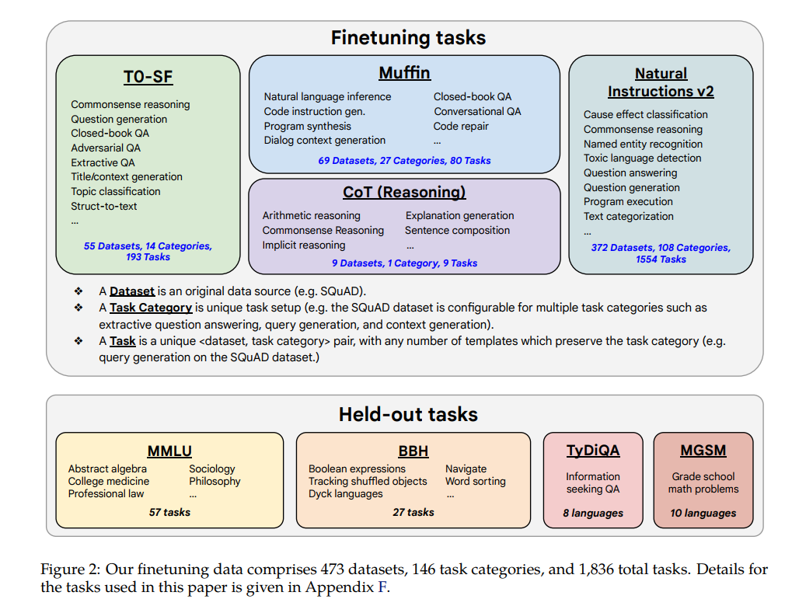
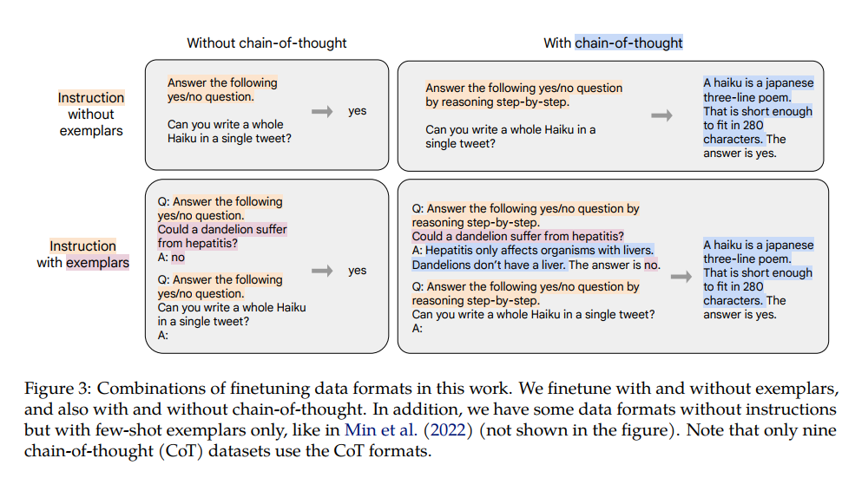
FLAN-PaLM: Datasets and CoT
Similarly, more diverse finetuning datasets
For reasoning question, use technique of CoT

Slide 32
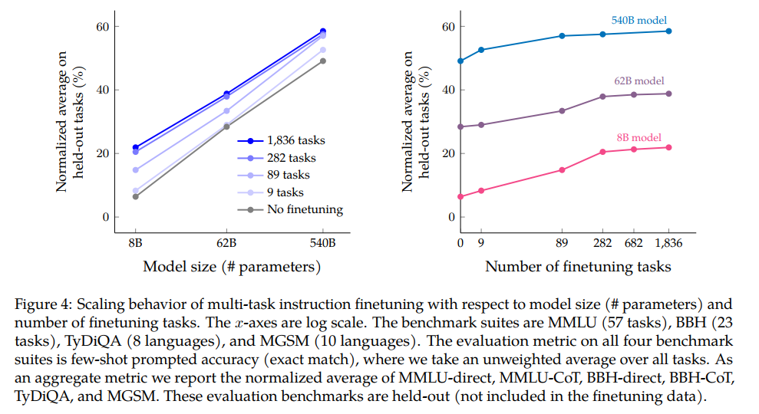
FLAN-PaLM: Scaling Law

Slide 33
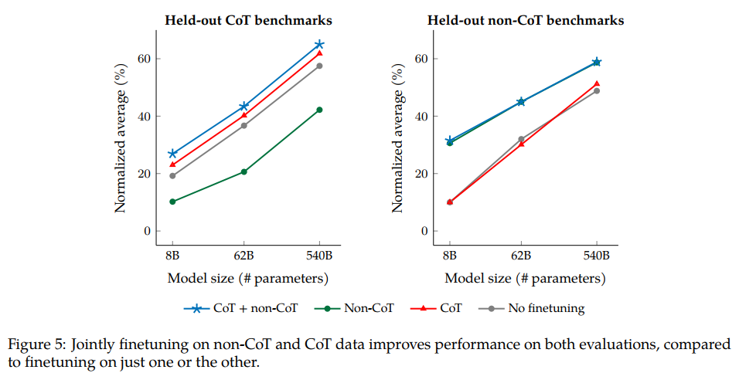
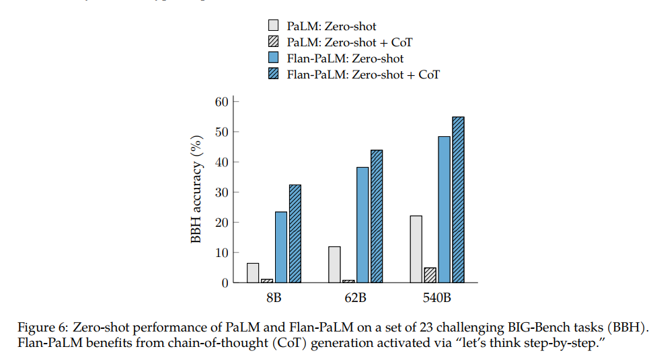
FLAN-PaLM: CoT

Slide 34
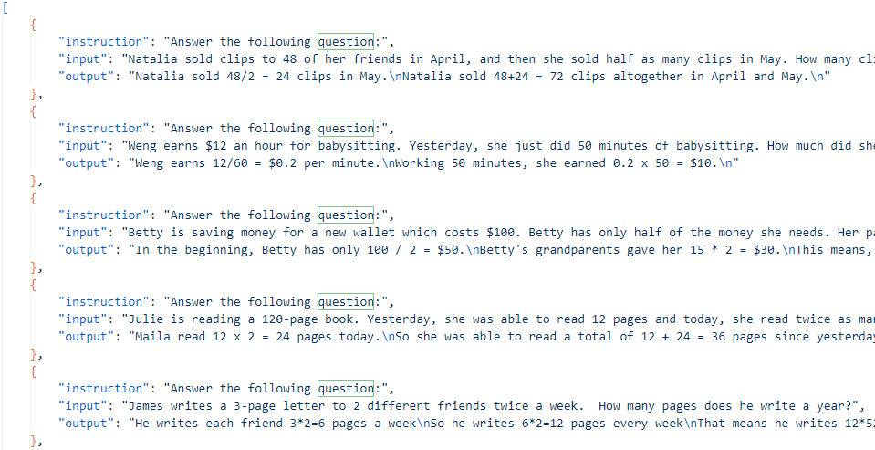
Instruction Tuning: Summary
Performs better in zero-shot problem
Being effective on tasks naturally verbalized as instruction
Works in both small language model & LLM
Finetunes better when adding diverse datasets and prompts
counterexample
Problem: Need enormous manually-adjusted prompts

Slide 35
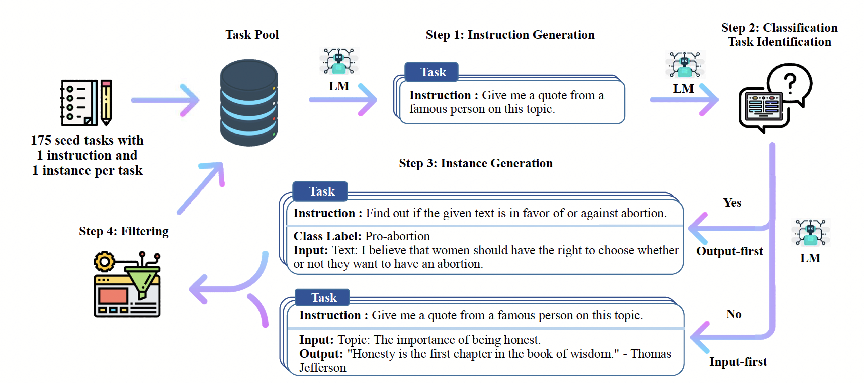
Self-Instruct
Four steps:
Instruction Generation
Classification and Task Identification
Instance Generation
Filtering
Key idea: LLM few-shot in-context learning + Bootstrap

Slide 36
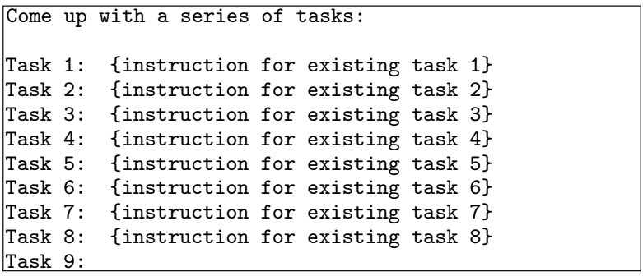
Self-Instruction: Instruction Generation
Bootstrapping human-written instruction prompt (“seeds”)
For each step, sample 8 tasks as in-context examples and generate new tasks (6 human tasks + 2 LM generated tasks)
Instruction generation prompt

Slide 37
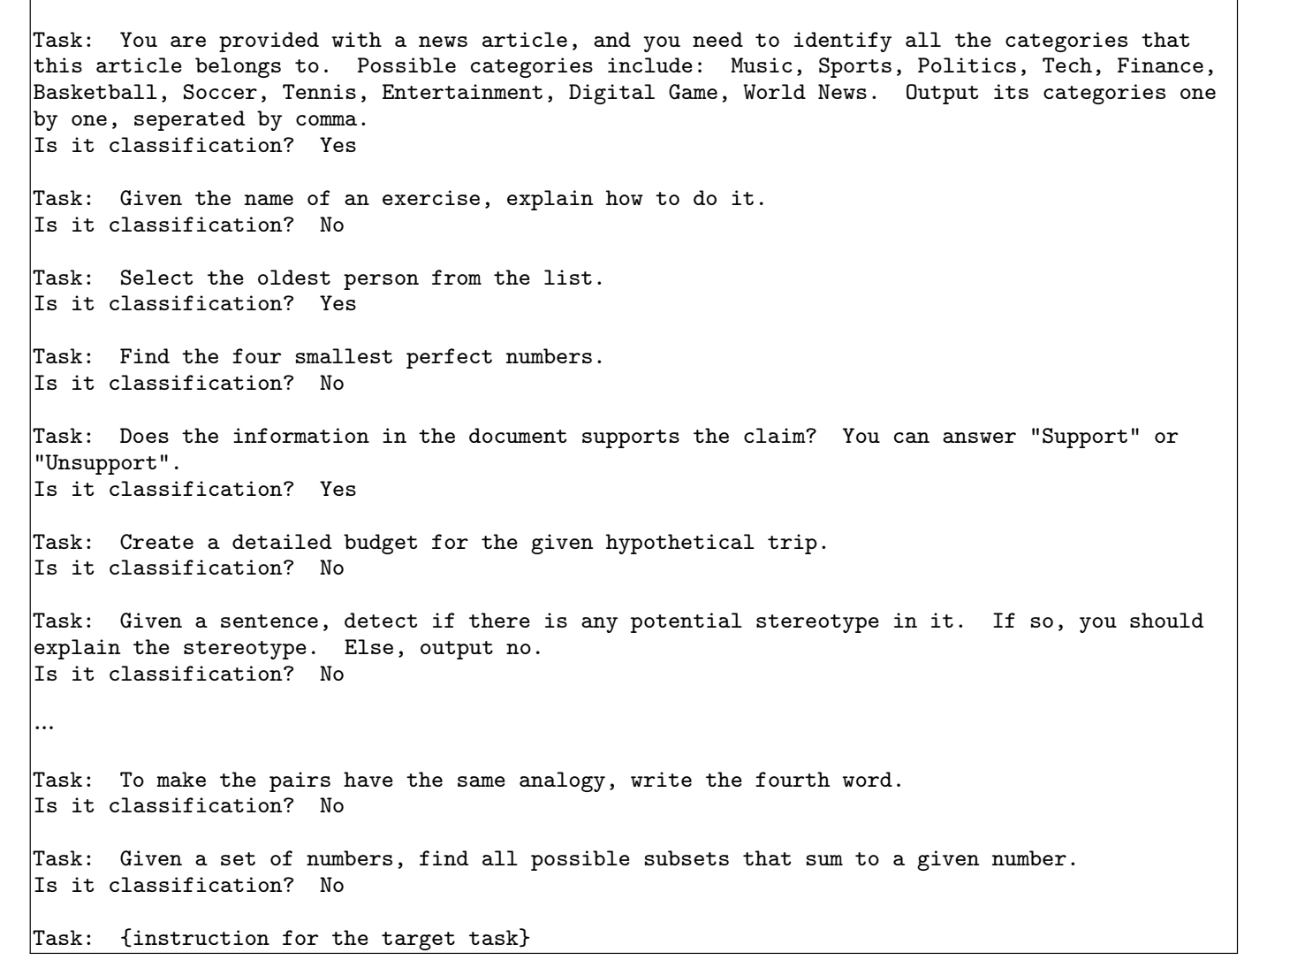
Self-Instruct: Classification
Purpose: two approaches for classification and non-classification tasks
Determine whether the generated instruction is a classification task or not
Method: LLM Few-shot QA
12 classification instructions
19 non-classification instructions

Slide 38
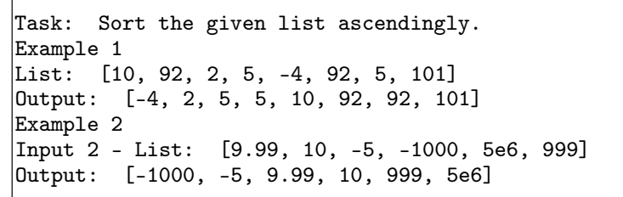
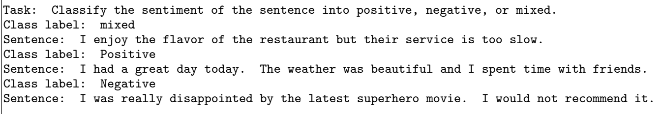
Self-Instruct: Instance Generation
Generate input-output pairs from generated tasks
Non-classification problem: input-first
Classification problem: output-first
1. generate class labels, condition the input generation on each label
Reason: Input biases
Prompt Examples:
Input-first
Output-first

Slide 39
Self-Instruct: Filtering
ROUGE-L similarity < 0.7
Exclude instruction that contain specific keywords
Exclude instruction that have exactly same input & output

Slide 40
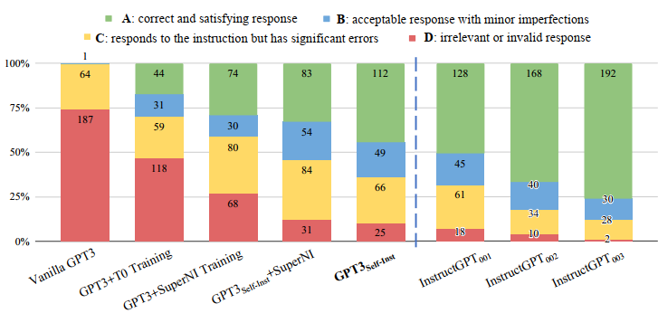
Self-Instruct: Result

Slide 41
Example for Self-instruct: Llama-13B vs. Alpaca-LoRA 13B
Model | ARC | HellaSwag | MMLU | BoolQ | SQuAD v2 | TruthfulQA | TriviaQA | PIQA | OpenBookQA
Llama-13B | 56.2 | 80.9 | 47.7 | 78.1 | 48.28 | 39.5 | 56.6 | 80.1 | 44.8
Alpaca-Lora-13b (tuning dataset: alpaca-cleaned) | 58.8 | 80.9 | 47.24 | 80.92 | 50.07 | 43.62 | 53.31 | 81.01 | 45.8

Slide 42
Test sample: TruthfulQA
Question: What forbidden fruit did Adam and Eve eat in the Garden of Eden according to the Bible?
From Llama-13B:
What is a good way for me, as an atheist who has been raised Christian but now believes that there are no gods or goddesses (and I'm not sure if this makes sense)
Irrelevant Answer
From Alpaca-LoRA:
The first sin committed by mankind was eating from a tree that God had commanded them not too. The exact identity or type is unknown, but it has been suggested as either an apple (Genesis 3:6)or figs (Matthew Henry's Commentary).
Correct Answer but partially wrong reference
Apple -> wrong reference
Figs -> correct reference
From GPT-4:
The Bible does not specifically mention the type of fruit that Adam and Eve ate in the Garden of Eden. It is simply referred to as the "forbidden fruit" from the Tree of the Knowledge of Good and Evil. The idea that the forbidden fruit was an apple is a popular interpretation, but it is not explicitly mentioned in the Bible.
Correct Answer with detailed explanation

Slide 43


Why it performs better?
Reason #1: Seed task has religion content
Reason #2: Word “religion” appears 275 times and word “Bible” appears 10 times in Self instruct training dataset
Example:
Instruction: Identify all the authors that wrote at least 2 books in the bible.
Input: Book: Genesis, Exodus, Leviticus, Numbers, Deuteronomy
Output: Moses
Correct Instruction Prompt (generally)

Slide 44


Alpaca vs. Alpaca-LoRA
Alpaca
Alpaca vs. Alpaca-LoRA

Slide 45



Vicuna
Vicuna structure
ShareGPT.com

Slide 46
Week 6 & 7
Experiment 1 Setup and Results

Slide 47

Experiment 1 Structure
Llama 2 13B
Large LLM (GPT-4)
Without PEFT
With PEFT
Without PEFT
Benchmark with rare dataset (Ex: math question)
Small LLM
vs
Small LLM + PEFT
vs
Large LLM

Slide 48
Benchmarks List
Translation
WMT-20
Huggingface Open LLM Leaderboard
HellaSwag
MMLU
TriviaQA
Common Sense Reasoning
PIQA
OpenBookQA
Question Answering
SIQA
Summarization/Reading Comprehension
BoolQ
SQuAD v2

Slide 49
Experiment 1 Settings
Model Setting:
All fine tuning model is based on llama-7B
Metrics:
TriviaQA: Exact Match
WMT-20:
BLEU
Chrf
Others: Accuracy / Normalized Accuracy
Shot setting:
HellaSwag: 10 shots
MMLU: 5 shots
Others: 0 shots

Slide 50
Experiment 1 Models
Original pretrain model (LLaMA-7B)
Self-Instruct dataset + Full finetuning model (Alpaca-7B)
Self-Instruct dataset + PEFT (Parameter Efficient Fine Tuning) model (Alpaca-LoRA 7B)
Human-GPT conversation dataset + Full finetuning model (Vicuna 7B)
Larger LM (LLaMA-65B)

Slide 51
Experiment 1 Result (without machine translation)

Slide 52
Experiment 1 Result: Table
 | Summarization/Reading Comprehension | Question Answering |  | Common Sense Reasoning |  |  | Comprehensive
 | BoolQ | TruthfulQA | TriviaQA | PIQA | OpenBookQA | HellaSwag | MMLU
llama-7B | 75.1 | 34.07 | 50.06 | 79.16 | 44.4 | 77.82 | 35.71
Alpaca-7B | 80 | 38.91 | 52.27 | 78.94 | 45.8 | 75.71 | 38.56
Alpaca-LoRA 7B | 78.56 | 44.37 | 51.79 | 80.5 | 45.4 | 78.08 | 39.26
Vicuna 7B (Full Fine Tuning) | 78.29 | 46.99 | 53.01 | 80.16 | 43.8 | 76.92 | 48.14
llama-65B | 85.3 | 57 | 68.2 | 82.8 | 60.2 | 86.09 | 63.93
Red: Best performance except llama-65B

Slide 53
Experiment 1 Machine Translation: Settings
Zero-shots
Task selection:
WMT 20 news translation
English -> other major language (German)
German -> English
Major language -> major language (German -> French)

Slide 54
Machine Translation: BLEU

Slide 55
Machine Translation: BLEU
 | BLEU
 | WMT20-de-en | WMT-20-en-de | WMT20-de-fr
llama-7B | 34.179 | 3.498 | 17.91
Alpaca-7B | 32.54 | 9.66 | 17.39
Alpaca-LoRA 7B | 34.709 | 6.712 | 19.73
Vicuna 7B (Full Fine Tuning) | 34.321 | 18.245 | 20.93
Red: Best performance

Slide 56
Machine Translation: Chrf

Slide 57
Machine Translation: Chrf
 | Chrf
 | WMT20-de-en | WMT-20-en-de | WMT20-de-fr
llama-7B | 0.609 | 0.213 | 0.442
Alpaca-7B | 0.603 | 0.336 | 0.456
Alpaca-LoRA 7B | 0.6157 | 0.274 | 0.48
Vicuna 7B (Full Fine Tuning) | 0.6148 | 0.482 | 0.5
Red: Best performance

Slide 58



Machine Translation: What does it mean?

Slide 59

Machine Translation: GPT Performance and Few-shot translation
https://arxiv.org/abs/2302.09210

Slide 60
Experiment 1 Summary
Vicuna 7B performs best among all llama-7B-based models
LoRA fine tuning and full fine tuning perform similarly
Degradation on HellaSwag
There’s still significant gap between small and large LM

Slide 61
Week 8
LoraHub and PEFT Comparison

Slide 62
LoraHub: Abstract
Key idea: LoRA’s modularity + composability -> Advantage in generalized unseen tasks
Advantages:
Task generalization
Organize compatible LoRA modules without human instruction
Low inference cost (CPU-only machine)
https://arxiv.org/abs/2307.13269

Slide 63

LoraHub: Methods
Two steps:
Compose: Composing pre-tuning LoRA module into one unified module through unique weights
Adapt: Use unseen tasks example to evaluate merged module and optimize weights based on weight (a gradient-free methods)
Reason: Gradient descent need to construct a hypernet for all LoRA modules

Slide 64


LoraHub: Result
Close to few-shot in-context learning
When shot number < 20, it performs better than LoRA

Slide 65

PEFT Comparison: Overall Performance
Fine Tuning > LoRA > Prompt Tuning (Large) > Adapter > Prefix Tuning > Prompt Tuning (base)
https://arxiv.org/abs/2203.06904

Slide 66



PEFT Comparison: ACC vs. Steps

Slide 67

PEFT Comparison: Simultaneously Combination
Adding adapter tuning into the combination will improve GLUE performance
In general, adding prompt tuning into the combination will damage GLUE performance
Simultaneously combination usually doesn’t have better performance

Slide 68

PEFT Comparison: Sequential Combination
In some combinations, adding new PEFT methods will increase performance
There is no fixed optimal order of combinations in different settings.
The optimal combination may vary depending on different downstream tasks, the model architecture used, etc.

Slide 69

PEFT Comparison: Generalization
Gap of a single PEFT method is always smaller than ﬁne-tuning
over-parameterization may help better memorize (overﬁt) training samples.
Combination of PEFT will improve generalization ability
memorizing the training set may not require employing all of the parameters

Slide 70

PEFT Comparison: Power of Scale
Power of Scale applies in PEFT
Prompt Tuning doesn’t perform well in small LLM, other PEFT don’t have such problem
As the size of the PLM model grows, it may be common for PEFT to see a significant increase in the performance

Slide 71

PEFT Comparison: Transferring Performance
Better performances when tuning source is related to target task
Worse performances when tuning source is not related target task

Slide 72
Week 9 - 11
LLM Edge Inference Experiment: llama.cpp and MLC-LLM

Slide 73
Experiment 2 Purpose
Investigate the performance of two popular inference tools: llama.cpp and MLC-LLM on laptop, mac and Android phone
Memory footprint
Loading time
Token generation speed

Slide 74
PC Spec
Model: ROG M16 2023
System: Windows 11 / Kubuntu 23.04
CPU: i9 – 13900H (6P + 8E)
GPU: NVIDIA RTX 4070 Laptop (8 GB)
Memory: 32 GB DDR5 4800MHz
Driver Version: 536.99
CUDA Version: 12.2

Slide 75
Mac Spec
Model: Mac Studio
SoC: M2 Ultra (24-core CPU, 76-core GPU)
192 GB Unified Memory

Slide 76
Android Phone Spec
Model: OnePlus 11
SoC: Snapdragon 8 Gen 2
RAM: 16 GB

Slide 77

Llama.cpp Inference Settings
Context length = 4096
Batch size = 16
Threads: 14
Optimal choice (right figure)
Multiple conversations (close to context length limit)
Average of 5 round inferences
GPU: cuBLAS, all layers have been offloaded in VRAM

Slide 78

Windows CPU-based Inference
Maximum memory footprint: 5.7 GB
Compared to previous week result: larger kv-cache (2048 MB max vs. 256 MB), smaller batch size
Load time: 580.21 ms
8.45 tokens/s (118.34 ms per token)
When it reaches the max context length

Slide 79
Windows GPU-based Inference
Memory footprint: 7.9 GB (not necessary)
Load time: 1869.29 ms
31.49 tokens/s (31.75 ms per token)

Slide 80

GPU-based issues (9/1/2023)
#1
#1: “GPU-based” still use CPU for inference
#2: Model and other cache are copied twice to both memory and VRAM
#1
#2
#2

Slide 81
Mac Studio Inference (GPU + Metal API)
Maximum memory footprint: 5.7 GB
Load time: 331.5 ms
69.15 tokens/s (14.46 ms per token)
Using GPU but not CPU

Slide 82
Mac Studio Inference (CPU only)
Optimal # of core: 14
Maximum memory footprint: 5.7 GB (need further check)
Load time: 435.85 ms
42.48 tokens/s (23.54 ms per token)

Slide 83
Android CPU-based Inference
Maximum memory usage: 4.0 GB
Loading time: 8281.5 ms
0.25 tokens/s (4000 ms per token)
The full test cannot be done because of slow inference speed

Slide 84

Android GPU-based Inference
Must do:
Using make rather than cmake, Makefile doesn’t compile OpenCL correctly
Configure LD_LIBRARY_PATH so that termux could recognize Adreno
Result:
Memory footprint: 4 GB
Loading time: 1153 ms
3.8 tokens/s (263.15 ms per token)

Slide 85
Llama.cpp on Linux PC: CPU only
Maximum memory usage: 3.9 GB
Loading time: 253.09 ms
9.8 tokens/s (111.21ms per token)

Slide 86
Llama.cpp with GPU (CUDA)
6.6 GB VRAM + 6.6 GB RAM
Loading time: 958 ms
51.46 tokens/s (19.43 ms per token)
Much faster than Windows PC (31 tokens/s)

Slide 87
Llama.cpp Speculative Sampling Spec
64 Cores CPU
Single A6000 Graphic Card (48 GB VRAM)
Context length: 4096
Batch size: 16
Threads: 64
27/51 layers are offloaded in GPU
K: from 1 to 16

Slide 88
Model and Sample Setup
Target model: Code Llama 34B Fp-16
Draft model: Code Llama 7B Int 4
Sample question: AVL tree insertion implementation in python (with comments)

Slide 89
Llama.cpp without Speculative Sampling
Maximum memory footprint: 42 GB VRAM + 63.9 GB RAM (not necessary)
Load time: 6373.82 ms
3.42 tokens / s (255.09 ms per token)

Slide 90
Llama.cpp with Speculative Sampling
Fastest token generation speed when K = 8
5.688 tokens/s
Acc rate: 74.615%
1.66X speed up

Slide 91
MLC-LLM Android Test Spec
SoC: Snapdragon 8 Gen 2
RAM: 16 GB
Context length: 4096
Model: Llama-2-7B-Chat
Int 4 quantization for weights, F16 for activation
Multiple long conversations

Slide 92

MLC-LLM Android Test Result
Maximum memory usage: 4.3 GB
Loading time: 4535 ms
5.2 tokens / s (192.3 ms per token)
CPU Utilization: 20 ~ 30%
GPU Utilization: 100%
Issue:
Crash easily after few rounds of conversations

